Slide 1
SRI RAMAKRISHNA ENGINEERING COLLEGE
[Educational Service : SNR Sons Charitable Trust]
[Autonomous Institution, Reaccredited by NAAC with ‘A+’ Grade]
[Approved by AICTE and Permanently Affiliated to Anna University, Chennai]
[ISO 9001-2015 Certified and all eligible programmes Accredited by NBA]
VATTAMALAIPALAYAM, N.G.G.O. COLONY POST, COIMBATORE – 641 022.
Department of Electronics and Communication Engineering
20EC214 & DIGITAL CMOS VLSI CIRCUITS
Course Instructor:
Mr.R.Chandru,
Assistant Professor(Sl.G)/ECE
No. of Credits : 3

Slide 2
20EC214 - DIGITAL CMOS VLSI CIRCUITS COURSE OUTCOMES
On successful completion of the course, students will be able to,
COURSE OUTCOMES
CO₁ | Interpret the characteristics and manufacturing process technologyof MOS transistor.
CO₂ | Analyze the various logic styles of CMOS combinational andsequential circuits
CO₃ | Design the various digital arithmetic logic circuits.
CO₄ | Illustrate the performance of the digital circuits by examining the timing issues.
CO₅ | Make use of MOS concepts in construction of Memory Array Subsystem.

Slide 3
20EC214 - DIGITAL CMOS VLSI CIRCUITS COURSE CONTENTS
PREREQUISITES
20EC204 - Digital System Design
MOS TRANSISTOR AND PROCESSING 10
MOSFET theory - Transistor switches - Compound gates - Design equations - IV characteristics - CV characteristics - Second order effects - Energy and Power - Resistance Estimation - Capacitance Estimation - Switching Characteristics - RC Delay Models - Logical Effort for gates - CMOS Process technology - Design Rules and Layout.
CMOS LOGIC STRUCTURES 11
Combinational Circuits: CMOS Inverter - DC Characteristics - Complementary Logic Structures - Ratioed logic - Pass transistor logic - Transmission gate - Tristate Inverter - Multiplexers - Dynamic logic structures. Sequential Circuits: Static latches and Registers, Dynamic latches and Registers, Pulse Registers, Sense Amplifier Based Register, Pipelining.
DESIGN OF ARITHMETIC BUILDING BLOCKS 8
Full adder, Ripple carry adder, Carry bypass adder, Linear and Square root carry-select adder, Carry look-ahead adder - Multipliers - Barrel and logarithmic shifter.
TIMING ISSUES 8
Timing Basics, Sources of Skew and Jitter, Clock-Distribution Techniques, Latch-Based locking, Self-Timed Circuit Design, Synchronizers and Arbiters, Clock Synthesis and Synchronization Using a Phase-Locked Loop.
MEMORY ARRAY SUBSYSTEM 8
SRAM: SRAM Cells, Row Circuitry, Column Circuitry. Multiported SRAM and Register files DRAM: Subarray Architectures, Column Circuitry, Embedded DRAM. Read-Only Memory: Programmable ROMs, NAND ROMs, Flash.

Slide 4
20EC214 - DIGITAL CMOS VLSI CIRCUITS COURSE CONTENTS
TEXT BOOKS
Neil H.E. Weste and David Harris, "CMOS VLSI Design A Circuits and Systems Perspective", 4th Edition, Pearson Education, Reprint 2010.
Jan M. Rabaey, Anantha Chandrakasan and B Nikolic, "Digital Integrated Circuits: A Design Perspective", 2nd Edition, Pearson Education India, 2016.
REFERENCES
Douglas. A. Pucknell, Kamran Eshraghian, "Basic VLSI Design", 3rd Edition, Prentice Hall India, 2010.
John P.Uyemura, "Introduction to VLSI Circuits and Systems", John Wiley & Sons, 2012.
WEB REFERENCES
https://nptel.ac.in/courses/108/107/108107129/
https://nptel.ac.in/courses/117/106/117106093/

Slide 5
MODULE 1 MOS TRANSISTOR AND PROCESSING TECHNOLOGY
MOSFET theory –
Transistor switches
Compound gates
Design equations - IV characteristics - CV characteristics
Second order effects
Energy and Power
Resistance Estimation
Capacitance Estimation
Switching Characteristics
RC Delay Models
Logical Effort for gates
CMOS Process technology
Design Rules and Layout

Slide 6
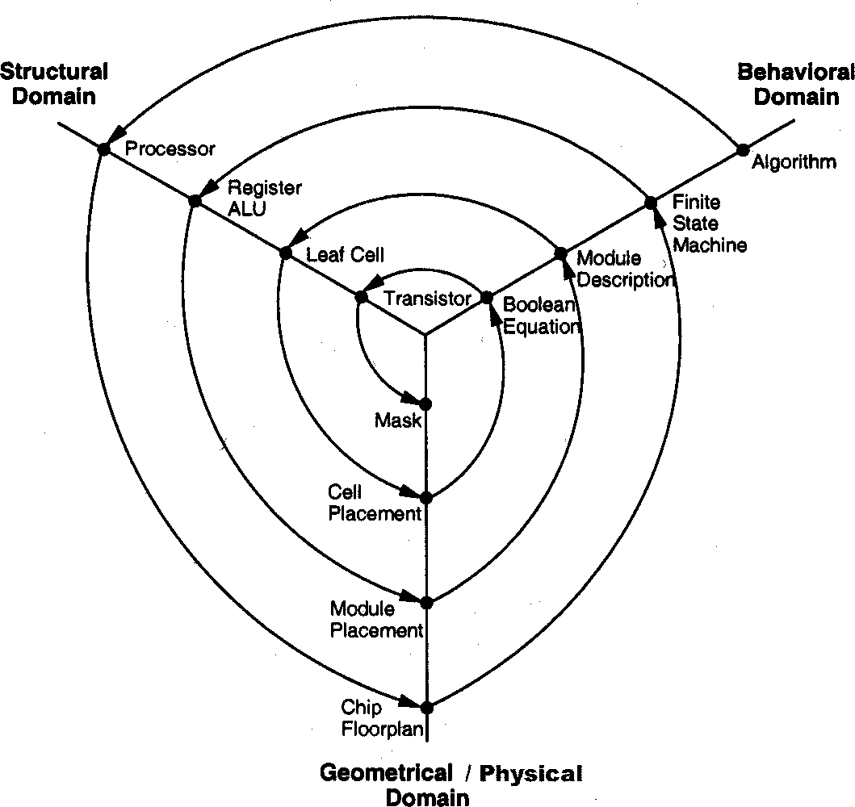
MODULE 1 MOS TRANSISTOR AND PROCESSING TECHNOLOGY
Gajski Y-Chart

Slide 7
MODULE 1 MOS TRANSISTOR AND PROCESSING TECHNOLOGY
The Y-chart consists of three major domains, namely:
Behavioral Domain
Structural Domain
Physical Domain
Physical/Geometry Domain:-
It is first necessary to subdivide a large system into small ASIC sized pieces which is referred as physical partition.
After that the small blocks are arranged together in the form of clusters.
Then the next step is floor plan where it is necessary to find out the approximate location of each module or block in the chip.
After that we can move on to module layout and cell layout where each unit of block to be placed on chip and the connections between the cells and the block is defined.
Gajski Y-Chart

Slide 8
MODULE 1 MOS TRANSISTOR AND PROCESSING TECHNOLOGY
Gajski Y-Chart
Behavioral Domain:-
The behavior of the entity can be modelled using procedural code which can represent the circuit at a higher level of abstraction.
First hierarchy is system where the behavior of the architecture is defined
Then a set of algorithm needs to be defined for processing the different parameters and a set of flowchart.
The third step is RTL where the coding needs to be done and then the logic level where we are concerned with 0 and 1 level, after which the transfer function is defined.
Structural Domain:-
A particular block is connected across with set of signals or netlist and here in this case we are more interested in the structure.

Slide 9
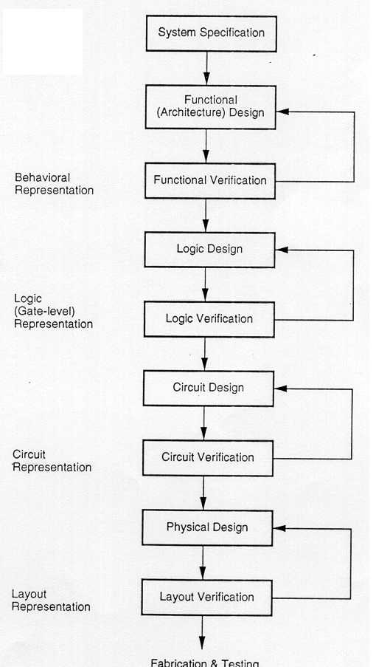
MODULE 1 MOS TRANSISTOR AND PROCESSING TECHNOLOGY
VLSI Design Flow
VLSI design cycle start with a formal specification of a VLSI chip, follows a series of steps, and eventually produces a packaged chip.

Slide 10
MODULE 1 MOS TRANSISTOR AND PROCESSING TECHNOLOGY
System Specification
First step of design process is to lay down the specification of the system.
High level representation of the system.
Factors considered:
Performance
Functionality
Physical dimension
Design technique
Fabrication technology
It is a compromise between market requirements, technological and economical viability.

Slide 11
MODULE 1 MOS TRANSISTOR AND PROCESSING TECHNOLOGY
Functional Design
Main functional units of the system are identified
Identifies the interconnect requirements between the units
The area, power and other parameters of each unit are estimated
The behavioral aspects of the system are considered not implementation specification
- multiplication needed but does not specify its hardware
The key idea is to specify behavior, in terms of
Input
Output
Timing of each unit
Without specifying the internal structure.

Slide 12
MODULE 1 MOS TRANSISTOR AND PROCESSING TECHNOLOGY
Logic Design X = (AB+CD)(E+F) Y= (A(B+C) + Z + D)
Design the logic, that is
Boolean expressions,
control flow,
word width,
register allocation, etc.
The outcome is called an RTL (Register Transfer Level) description.
RTL is expressed in a HDL (Hardware Description Language), such as VHDL and Verilog.
This description can be used in simulation and verification.
As this description consists of Boolean expressions, so they can be minimized to achieve the smallest logic design.

Slide 13
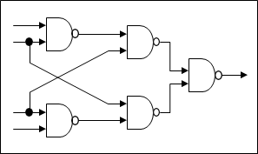
MODULE 1 MOS TRANSISTOR AND PROCESSING TECHNOLOGY
Circuit Design
The purpose of the circuit design is to develop a circuit representation based on the logic design.
The Boolean expression can be converted into a circuit representation by taking into consideration the speed and power requirements of the original design.
Design the circuit including gates, transistors, interconnections, etc. The outcome is called a netlist.
Circuit simulation is used to verify the correctness and timing of component.

Slide 14
MODULE 1 MOS TRANSISTOR AND PROCESSING TECHNOLOGY
Physical Design
The circuit representation of each component is converted into geometric representation.
Convert the netlist into a geometric representation. The outcome is called a layout.
Connections between different components are also expressed as a geometric pattern.
Exact details depends upon design rules
It is a complex process and usually broken down into sub-steps.
Various verification and validation checks are performed on the layout during physical design.

Slide 15
MODULE 1 MOS TRANSISTOR AND PROCESSING TECHNOLOGY
Fabrication
Fabrication Process includes,
- lithography,
- polishing,
- deposition,
- diffusion, etc.,
to produce a chip.
Fabrication process consists of several steps and requires various masks.
Before the chip is mass produced, a prototype is made and tested

Slide 16
MODULE 1 MOS TRANSISTOR AND PROCESSING TECHNOLOGY
Packaging, Testing and Debugging
Packaging
Put together the chips on a PCB (Printed Circuit Board) or an MCM (Multi-Chip Module)
Each chip is then packaged and tested to ensure that it meets all the design specifications and that it functions properly.

Slide 17
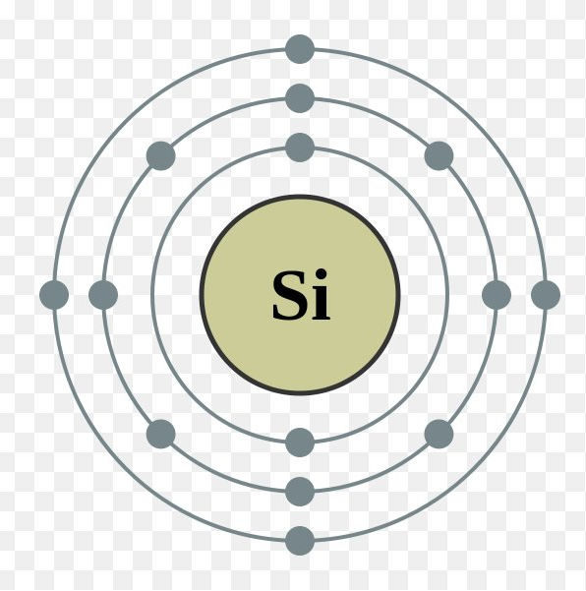
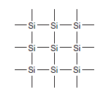
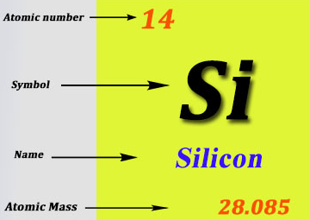
MODULE 1 MOS TRANSISTOR AND PROCESSING TECHNOLOGY
MOS Transistors
Introduction
Silicon (Si),
A semiconductor, forms the basic starting material for most integrated circuits
Pure silicon consists of a three-dimensional lattice of atoms
Silicon is a Group IV element, so it forms covalent bonds with four adjacent atoms, as shown below

Slide 18
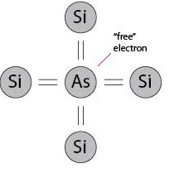
MODULE 1 MOS TRANSISTOR AND PROCESSING TECHNOLOGY
MOS Transistors
Silicon valence electrons are involved in chemical bonds, pure silicon is a poor conductor.
The conductivity can be raised by introducing small amounts of impurities, called dopants, into the silicon lattice.
A dopant from Group V of the periodic table, such as arsenic, has five valence electrons. It replaces a silicon atom in the lattice and still bonds to four neighbors, so the fifth valence electron is loosely bound to the arsenic atom, as shown below

Slide 19
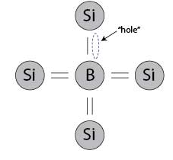
MODULE 1 MOS TRANSISTOR AND PROCESSING TECHNOLOGY
MOS Transistors
Thermal vibration of the lattice at room temperature is enough to set the electron free to move,
leaving a positively charged As+ ion and a free electron.
The free electron can carry current so the conductivity is higher
this is an n-type semiconductor because the free carriers are negatively charged electrons.
Group III dopant, such as boron, has three valence electrons, as shown below,
The dopant atom can borrow an electron from a neighboring silicon atom, which in turn becomes short by one electron.
That atom in turn can borrow an electron, and the missing electron, or hole, can propagate about the lattice.
The hole acts as a positive carrier, call this a p-type semiconductor.

Slide 20
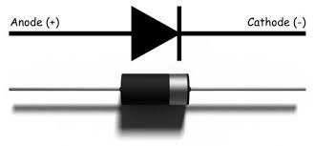
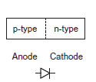
MODULE 1 MOS TRANSISTOR AND PROCESSING TECHNOLOGY
MOS Transistors
A junction between p-type and n-type silicon is called a diode, as show.
When the voltage on the p-type semiconductor, called the anode, is raised above the n-type cathode, the diode is forward biased and current flows.
When the anode voltage is less than or equal to the cathode voltage, the diode is reverse biased and very little current flows.

Slide 21
MODULE 1 MOS TRANSISTOR AND PROCESSING TECHNOLOGY
MOS Transistors
Metal-Oxide-Semiconductor (MOS) structure,
Created by superimposing several layers of conducting and insulating materials to form a sandwich-like structure.
structures are manufactured using a series of chemical processing steps involving,
Oxidation of the silicon,
selective introduction of dopants,
and deposition and etching of metal wires and contacts.

Slide 22
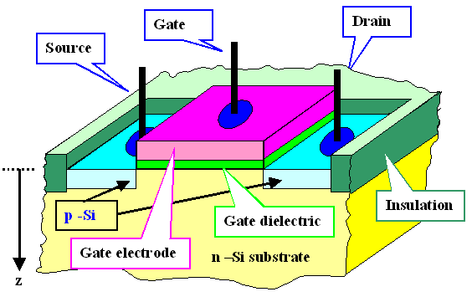
MODULE 1 MOS TRANSISTOR AND PROCESSING TECHNOLOGY
MOS Transistors
Metal-Oxide-Semiconductor (MOS) structure,
CMOS technology provides two types of transistors,
n-type transistor (nMOS)
p-type transistor (pMOS)
Transistor operation is controlled by electric fields so called Metal Oxide Semiconductor Field Effect Transistors (MOSFETs) or simply FETs.

Slide 23
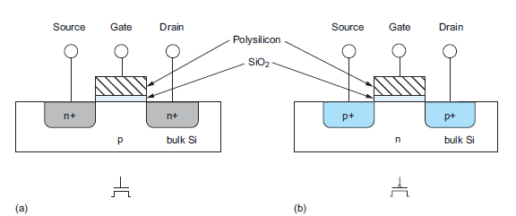
MODULE 1 MOS TRANSISTOR AND PROCESSING TECHNOLOGY
MOS Transistors
Metal-Oxide-Semiconductor (MOS) structure,
Cross-sections and symbols of these transistors are shown below. The n+ and p+ regions indicate heavily doped n- or p- type silicon.
a) n-MOS b) p-MOS

Slide 24
MODULE 1 MOS TRANSISTOR AND PROCESSING TECHNOLOGY
MOS Transistors
Transistor consists of,
a stack of the conducting gate
an insulating layer of silicon dioxide (SiO2, known as glass)
the substrate (silicon wafer)
body, or bulk.
Gates of early transistors,
were built from metal, the stack was called metal oxide-semiconductor or MOS.
1970s, the gate has been formed from polycrystalline silicon (polysilicon), but the name stuck.
metal gates reemerged in 2007, to solve materials problems in advanced manufacturing processes

Slide 25
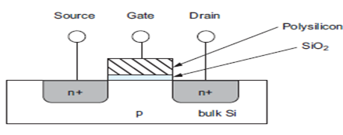
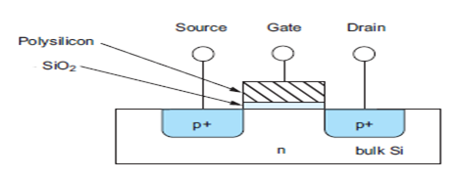
MODULE 1 MOS TRANSISTOR AND PROCESSING TECHNOLOGY
MOS Transistors
An nMOS transistor,
is built with a p-type body
has regions of n-type semiconductor adjacent to the gate called the source and drain.
The body is typically grounded.
A pMOS transistor,
is just the opposite, consisting of p-type source and drain regions with an n-type body.

Slide 26
MODULE 1 MOS TRANSISTOR AND PROCESSING TECHNOLOGY
MOS Transistors – As a Switch
An nMOS Transistor,
The body is generally grounded so the p–n junctions of the source and drain to body are reverse-biased.
If the gate is also grounded,
no current flows through the reverse-biased junctions, the transistor is OFF.
If the gate voltage is raised,
it creates an electric field that starts to attract free electrons to the underside of the Si–SiO2 interface.
If the voltage is raised enough,
the electrons out number the holes and a thin region under the gate called the channel is inverted to act as an n-type semiconductor.
a conducting path of electron carriers is formed from source to drain and current can flow, the transistor is ON.

Slide 27
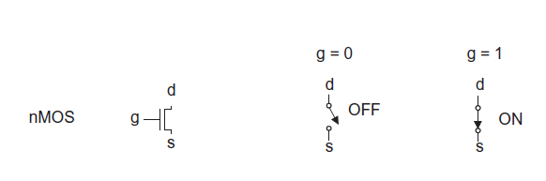
MODULE 1 MOS TRANSISTOR AND PROCESSING TECHNOLOGY
MOS Transistors – As a Switch
An nMOS Transistor,
When the gate of an nMOS transistor is 0,
the transistor is OFF and no current flows from source to drain
When the gate of an nMOS transistor is 1,
the transistor is ON and there is a conducting path from source to drain

Slide 28
MODULE 1 MOS TRANSISTOR AND PROCESSING TECHNOLOGY
MOS Transistors – As a Switch
A pMOS transistor,
The situation is again reversed. The body is held at a positive voltage.
When the gate is also at a positive voltage,
the source and drain junctions are reverse-biased and no current flows, the transistor is OFF.
When the gate voltage is lowered,
positive charges are attracted to the underside of the Si–SiO2 interface.
A sufficiently low gate voltage,
inverts the channel and a conducting path of positive carriers is formed from source to drain, the transistor is ON.

Slide 29

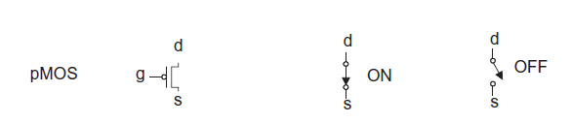
MODULE 1 MOS TRANSISTOR AND PROCESSING TECHNOLOGY
MOS Transistors – As a Switch
A pMOS transistor,
When the gate of an pMOS transistor is 0,
the transistor is ON and there is a conducting path from source to drain
When the gate of an pMOS transistor is 1,
the transistor is OFF and no current flows from source to drain
Notice : The symbol for the pMOS transistor has a bubble on the gate, indicating that the transistor behavior is the opposite of the nMOS.

Slide 30
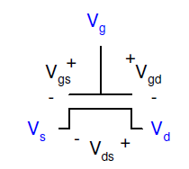
MODULE 1 MOS TRANSISTOR AND PROCESSING TECHNOLOGY
MOS Transistors – Theory & Terminal Voltages
nMOS transistor:
majority carriers are electrons(greater mobility)
p-substrate doped (positively doped)
pMOS transistor:
majority carriers are holes (lessmobility),
n-substrate (negatively doped)
Mode of operation depends on V_{g}, V_{g}, V_{s}
V_{gs} = V_{g} – V_{s}
V_{gd} = V_{g} – V_{d}
V_{ds} = V_{d} – V_{s} = V_{gs} - V
Source and drain are symmetric diffusion terminals
By convention, source is terminal at lower voltage
Hence V_{ds} ≥ 0

Slide 31
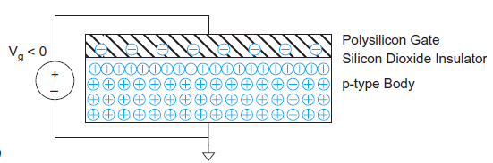
MODULE 1 MOS TRANSISTOR AND PROCESSING TECHNOLOGY
MOS Transistors – Theory
Simple MOS structure :
The top layer of the structure is a good conductor called the gate.
Early transistors used metal gates.
Transistor gates soon changed to use polysilicon, i.e., silicon formed from many small crystals, although metal gates are making a resurgence at 65 nm and beyond.
The middle layer is a very thin insulating film of SiO2 called the gate oxide.
The bottom layer is the doped silicon body.
The figure shows a p-type body in which the carriers are holes. The body is grounded and a voltage is applied to the gate. The gate oxide is a good insulator so almost zero current flows from the gate to the body.

Slide 32
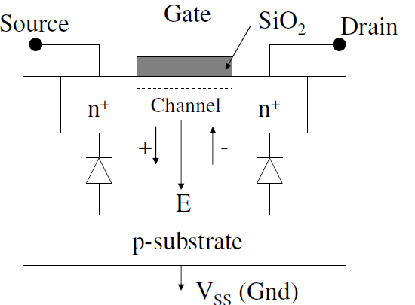
MODULE 1 MOS TRANSISTOR AND PROCESSING TECHNOLOGY
nMOS Transistors - Operating Modes
Gate Biasing :
Vgs=0:
no current flows from source to drain (insulated by two reverse biased pn junctions
Vgs>0:
electric field created across substrate
Electrons accumulate under gate: region changes from p-type to n-type
Conduction path between source and drain
Enhancement - mode transistor: Conducts when gate bias Vgs > Vt
Depletion - mode transistor: Conducts when gate bias is zero

Slide 33
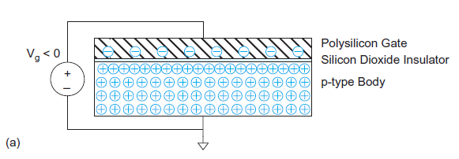
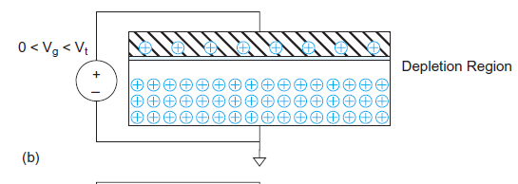
MODULE 1 MOS TRANSISTOR AND PROCESSING TECHNOLOGY
nMOS Transistors - Operating Modes
Accumulation Mode: Figure (a)
A negative voltage is applied to the gate, so there is negative charge on the gate.
The mobile positively charged holes are attracted to the region beneath the gate. This is called the accumulation mode.
Depletion Mode : Figure (b)
A small positive voltage is applied to the gate, resulting in some positive charge on the gate.
The holes in the body are repelled from the region directly beneath the gate, resulting in a depletion region forming below the gate.

Slide 34
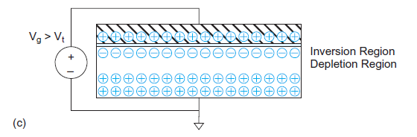
MODULE 1 MOS TRANSISTOR AND PROCESSING TECHNOLOGY
nMOS Transistors - Operating Modes
Inversion Mode: Figure (c)
A higher positive potential exceeding acritical threshold voltage Vt is applied, attracting more positive charge to the gate.
The holes are repelled further and some free electrons in the body are attracted to the region beneath the gate. This conductive layer of electrons in the p-type body is called the inversion layer

Slide 35
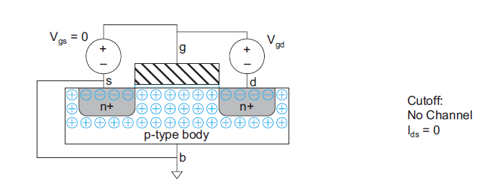
MODULE 1 MOS TRANSISTOR AND PROCESSING TECHNOLOGY
nMOS Transistors – Regions of Operation
Three regions of operation
Cutoff
Linear
Saturation
The transistor consists of the MOS stack between two n-type regions called the source and drain.
In the above Figure,
The gate-to-source voltage Vgs is less than the threshold voltage V_{t}
The source and drain have free electrons
The body has free holes but no free electrons
If the source is grounded,
The junctions between the body and the source or drain are zero-biased or reverse-biased, little or no current flows, the transistor is OFF, and this mode of operation is called cutoff.

Slide 36
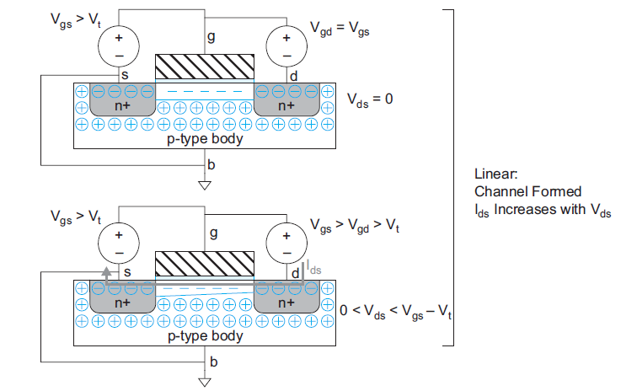
MODULE 1 MOS TRANSISTOR AND PROCESSING TECHNOLOGY
nMOS Transistors –
Regions of Operation
In first figure,
the gate voltage is greater than the threshold voltage
an inversion region of electrons (majority carriers) called the channel connects the source and drain, creating a conductive path and turning the transistor ON.
The number of carriers and the conductivity increases with the gate voltage. The potential difference between drain and source is
there is no electric field tending to push current from drain to source.

Slide 37
MODULE 1 MOS TRANSISTOR AND PROCESSING TECHNOLOGY
nMOS Transistors – Regions of Operation
In Second figure,
When a small positive potential V_{ds} is applied to the drain
current I_{ds} flows through the channel from drain to source.
This mode of operation is termed linear, resistive, triode, non-saturate or unsaturated
The current increases with both the drain voltageand gate voltage

Slide 38
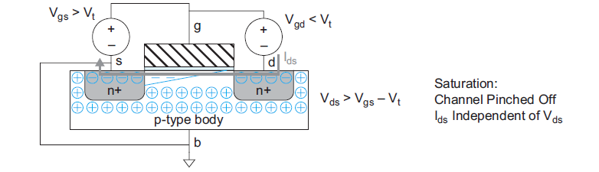
MODULE 1 MOS TRANSISTOR AND PROCESSING TECHNOLOGY
nMOS Transistors – Regions of Operation
If V_{ds} becomes sufficiently large that V_{gd} < V_{t} ,
the channel is no longer inverted near the drain and becomes pinched off
Conduction is still brought about by the drift of electrons under the influence of the positive drain voltage.
As electrons reach the end of the channel, they are injected into the depletion region near the drain and accelerated toward the drain.
Above this drain voltage the current I_{ds} is controlled only by the gate voltage and ceases to be influenced by the drain. This mode is called saturation.

Slide 39
MODULE 1 MOS TRANSISTOR AND PROCESSING TECHNOLOGY
nMOS Transistors – Regions of Operation
Summary:
The nMOS transistor has three modes of operation
If V_{gs} < V_{t} ,
the transistor is cutoff (OFF).
If V_{gs} > V_{t} ,
the transistor turns ON.
If V_{ds} is small,
the transistor acts as a linear resistor in which the current flow is proportional to V_{ds}.
If V_{gs} > V_{t} and V_{ds} is large,
the transistor acts as a current source in which the current flow becomes independent of V_{ds} .

Slide 40
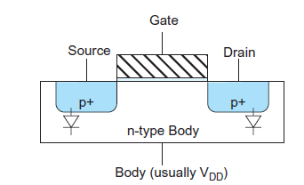
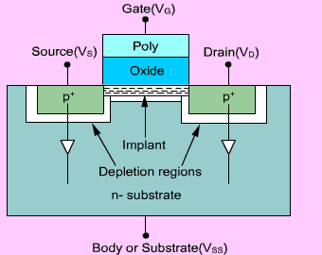
MODULE 1 MOS TRANSISTOR AND PROCESSING TECHNOLOGY
pMOS Transistors – Operation
pMOS transistor,
Operates in just the opposite fashion to nMOS transistor
The n-type body is tied to a high potential so the junctions with the p-type source and drain are normally reverse-biased.
When the gate is also at a high potential,
no current flows between drain and source
When the gate voltage is lowered by a threshold Vt ,
holes are attracted to form a p-type channel immediately beneath the gate, allowing current to flow between drain and source

Slide 41
MODULE 1 MOS TRANSISTOR AND PROCESSING TECHNOLOGY
pMOS Transistors – Operation
Vgs >> Vt : Transistor OFF
Majority carrier in channel (electrons)
No current from source to drain
0 > Vgs >Vt : Depletion region
Electric field repels majority carriers (electrons)
Depletion region forms - no carriers in channel
No current flows (except for leakage current)
Vgs < Vt , VDS=0: Transistor ON
Electric field attracts minority carriers (holes)
Inversion region forms in channel
Depletion layer insulates channel from substrate
Current can now flow from source to drain!

Slide 42
MODULE 1 MOS TRANSISTOR AND PROCESSING TECHNOLOGY
pMOS Transistors – Operation
Vgs <Vt , VDS >VGS -VT :Linear (Active) mode
Combined electric fields shift channel and depletion region
Current flow dependent on VGS, VDS
Vgs < Vt , VDS <VGS -VT :Saturation mode
Channel “pinched off”
Current still flows due to hole drift
Current flow dependent on VGS

Slide 43
MODULE 1 MOS TRANSISTOR AND PROCESSING TECHNOLOGY
MOS Device Design Equation – I V Characteristics
MOS transistors have three regions of operation:
Cut-off or subthreshold region
Linear region
Saturation region
To derive a model relating the current and voltage(I-V) for an nMOS transistor in each of these regions.
The model assumes that,
the channel length is long enough that the electric field (the field between source and drain) is relatively low
This model is variously known as the long-channel, ideal, first-order, or Shockley model.

Slide 44

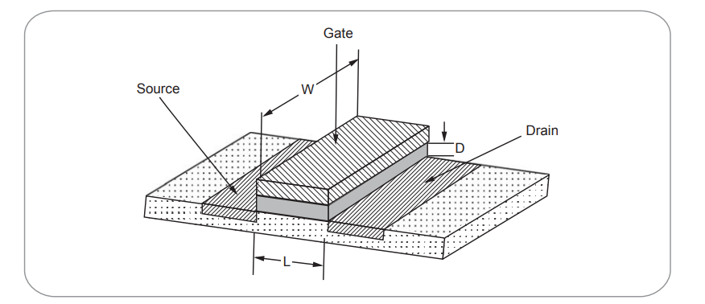

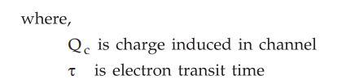



MODULE 1 MOS TRANSISTOR AND PROCESSING TECHNOLOGY

Slide 45
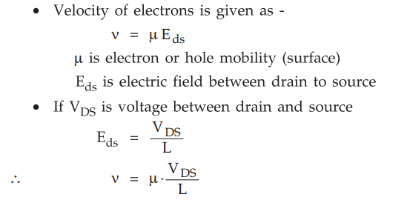


MODULE 1 MOS TRANSISTOR AND PROCESSING TECHNOLOGY

Slide 46

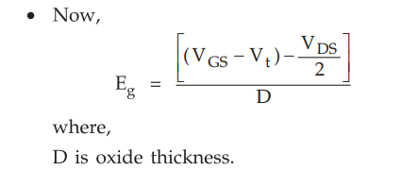



MODULE 1 MOS TRANSISTOR AND PROCESSING TECHNOLOGY

Slide 47






MODULE 1 MOS TRANSISTOR AND PROCESSING TECHNOLOGY
Veffective​ = gate voltage seen by the channel

Slide 48





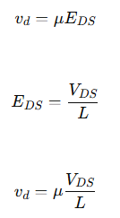


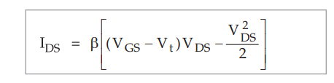
MODULE 1 MOS TRANSISTOR AND PROCESSING TECHNOLOGY
Drain current is:
Electron drift velocity:

Slide 49
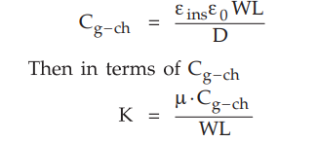

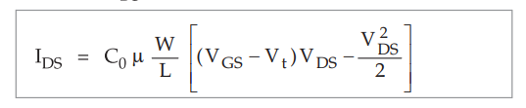

MODULE 1 MOS TRANSISTOR AND PROCESSING TECHNOLOGY

Slide 50


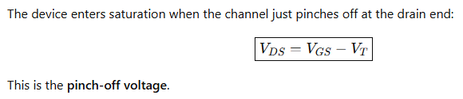

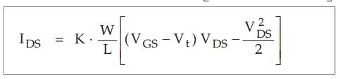



MODULE 1 MOS TRANSISTOR AND PROCESSING TECHNOLOGY

Slide 51
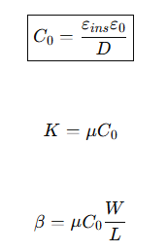
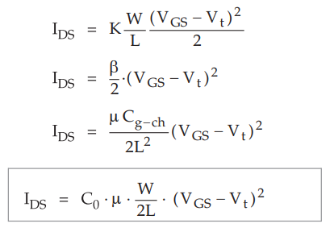
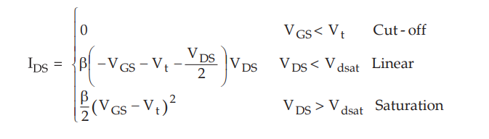
MODULE 1 MOS TRANSISTOR AND PROCESSING TECHNOLOGY

Slide 52
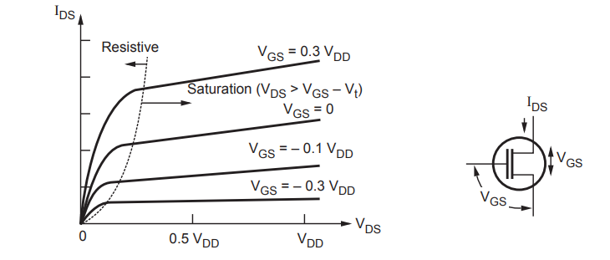
MODULE 1 MOS TRANSISTOR AND PROCESSING TECHNOLOGY

Slide 53
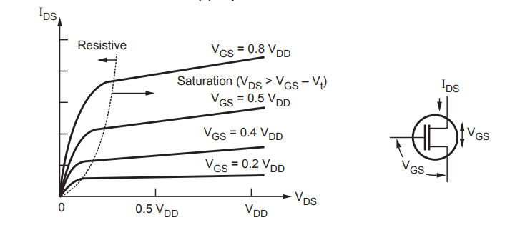
MODULE 1 MOS TRANSISTOR AND PROCESSING TECHNOLOGY

Slide 54
MODULE 1 MOS TRANSISTOR AND PROCESSING TECHNOLOGY

Slide 55
MODULE 1 MOS TRANSISTOR AND PROCESSING TECHNOLOGY
MOS Device Design Equation - I V Characteristics
The long-channel model assumes,
the current through an OFF transistor is 0.
When a transistor turns ON, (Vgs > Vt),
the gate attracts carriers (electrons) to form a channel
the electrons drift from source to drain at a rate proportional to the electric field between these regions.
We can compute currents if we know the amount of charge in the channel and the rate at which it moves
The charge on each plate of a capacitor is
Q = CV

Slide 56

MODULE 1 MOS TRANSISTOR AND PROCESSING TECHNOLOGY
MOS Device Design Equation - I V Characteristics
The charge in the channel Q_{channel} is,
where,
C_{g}, is the capacitance of the gate to the channel
(V_{gc} – V_{t}), is the amount of voltage attracting charge to the channel beyond the minimum required to invert from p to n.
The gate voltage is referenced to the channel, which is not grounded
If the source is at V_{s} and the drain is at V_{d} , the average is
V_{c} = (V_{s} + V_{d})/2 = V_{s} + V_{ds} /2

Slide 57
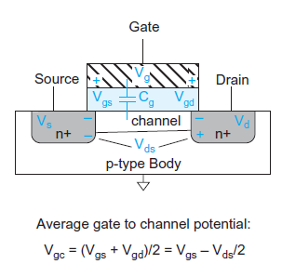

MODULE 1 MOS TRANSISTOR AND PROCESSING TECHNOLOGY
MOS Device Design Equation - I V Characteristics
The mean difference between the gate and channel potentials V_{gc} is,
V_{g} – V_{c} = V_{gs} – V_{ds} /2

Slide 58
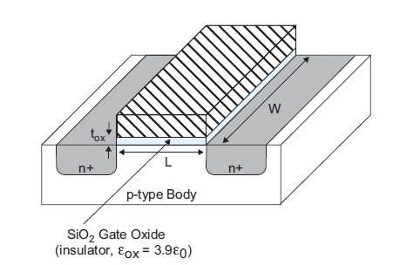

MODULE 1 MOS TRANSISTOR AND PROCESSING TECHNOLOGY
MOS Device Design Equation - I V Characteristics
Model the gate as a parallel plate capacitor with capacitance proportional to area over thickness.
If the gate has length L and width W and the oxide thickness is t_{ox}, as shown in the figure the capacitance is,

Slide 59


MODULE 1 MOS TRANSISTOR AND PROCESSING TECHNOLOGY
MOS Device Design Equation - I V Characteristics
is the permittivity of free space, 8.85 × 10^{–14} F/cm
the permittivity of SiO2 is kox = 3.9 times as great
term is called C_{ox}, the capacitance per unit area of the gate oxide
Gate Dielectric with a higher dielectric constant,
t_{ox} is called the equivalent oxide thickness (EOT)
The thickness of a layer of SiO₂ , that has the same C_{ox}
tox is thinner than the actual dielectric

Slide 60

MODULE 1 MOS TRANSISTOR AND PROCESSING TECHNOLOGY
MOS Device Design Equation - I V Characteristics
Each carrier in the channel,
is accelerated to an average velocity, v, proportional to the lateral electric field,
i.e., the field between source and drain.
The constant of proportionality µ is called the mobility
v = µE
A typical value of µ for electrons in an nMOS transistor with low electric fields is 500–700 cm2/V· s.
The electric field E is the voltage difference between drain and source V_{ds} divided by the channel length

Slide 61
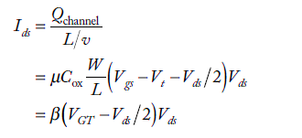

MODULE 1 MOS TRANSISTOR AND PROCESSING TECHNOLOGY
MOS Device Design Equation- I V Characteristics
The time required for carriers to cross the channel is the channel length divided by the carrier velocity: L/v
The current between source and drain is the total amount of charge in the channel divided by the time required to cross
The geometry and technology-dependent parameters are some times merged into a single factor - β
The term V_{gs} – V_{t} arises so often that it is convenient to abbreviate it as V_{GT}

Slide 62
MODULE 1 MOS TRANSISTOR AND PROCESSING TECHNOLOGY
MOS Device Design Equation - I V Characteristics
In the equation,
V_{gs} > V_{t} , but V_{ds} relatively small, It is called linear or resistive because when V_{ds} << V_{GT}, I_{ds} increases almost linearly with V_{ds}, just like an ideal resistor.

Slide 63

MODULE 1 MOS TRANSISTOR AND PROCESSING TECHNOLOGY
MOS Device Design Equation - I V Characteristics
In the equation,
If V_{ds} > V_{dsat} = V_{GT}, the channel is no longer inverted in the vicinity of the drain, say it is pinched off.
Beyond this point, called the drain saturation voltage, increasing the drain voltage has no further effect on current.
Substituting, V_{ds} = V_{dsat} at this point of maximum current into above equation, the expression for the saturation current that is independent of V_{ds}.

Slide 64
MODULE 1 MOS TRANSISTOR AND PROCESSING TECHNOLOGY
MOS Device Design Equation - I V Characteristics
The above expression is valid for V_{gs} > V_{t} and V_{ds} > V_{dsat}
Thus, long-channel MOS transistors are said to exhibit square-law behavior in saturation.
Two key figures of merit for a transistor are I_{on} and I_{off}.
I_{on} (also called I_{dsa}t) is the ON current, I_{ds}
When, V_{gs} = V_{ds} = V_{DD}.
I_{off} is the OFF current
when V_{gs} = 0 and V_{ds} = V_{DD}
According to the long-channel model,
I_{off} = 0 and

Slide 65
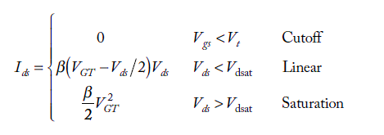
MODULE 1 MOS TRANSISTOR AND PROCESSING TECHNOLOGY
MOS Device Design Equation - I V Characteristics
The current in the three regions :

Slide 66
MODULE 1 MOS TRANSISTOR AND PROCESSING TECHNOLOGY
MOS Device Design Equation - I V Characteristics
nMOS I-V characteristics of ideal 4/2 λ
THE FIRST-ORDER MODEL,
The current is zero for gate voltages below V_{t}
For higher gate voltages,
Current increases linearly with V_{ds} for small V_{ds}
As V_{ds} reaches the saturation point
V_{dsat} = V_{GT}
Current rolls off and eventually becomes independent of V_{ds} when the transistor is saturated.
THE SHOCKLEY MODEL,
Over estimates current at high voltage because it does not account for mobility degradation and velocity saturation caused by the high electric fields.

Slide 67
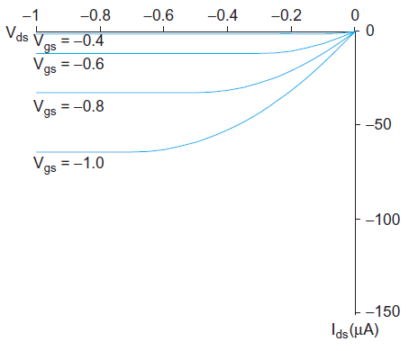
MODULE 1 MOS TRANSISTOR AND PROCESSING TECHNOLOGY
MOS Device Design Equation - I V Characteristics
pMOS I-V characteristics of ideal 4/2 λ
pMOS transistors behave in the same way, but with the signs of all voltages and currents reversed.
The I-V characteristics are in the third quadrant
The current flows from source to drain in a pMOS transistor.
The mobility of holes in silicon is typically lower than that of electrons.
This means that pMOS transistors provide less current than nMOS transistors of comparable size and hence are slower.

Slide 68

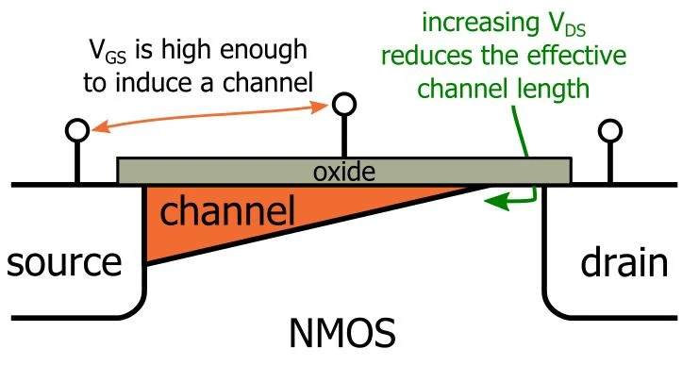
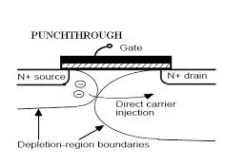
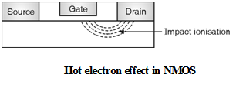
MODULE 1 MOS TRANSISTOR AND PROCESSING TECHNOLOGY
Threshold Voltage
Body Effect
Sub-Threshold Region
Channel-Length Modulation
Mobility Variation
Fowler-Nordheim Tunneling
Drain Punch through
Impact Ionization-Hot electrons

Slide 69




MODULE 1 MOS TRANSISTOR AND PROCESSING TECHNOLOGY
Body Effect
The threshold voltage VT​ of a MOSFET increases when the source is at a higher potential than the substrate (body).
The body effect is a second-order effect in MOSFETs where the threshold voltage increases when there is a voltage difference between the source and substrate. As the source-to-body voltage increases, the reverse bias of the source–body junction increases, widening the depletion region and increasing the depletion charge. To maintain charge neutrality, the inversion charge must reduce, requiring a higher gate voltage to form the channel. This results in an increase in threshold voltage.

Slide 70

MODULE 1 MOS TRANSISTOR AND PROCESSING TECHNOLOGY
Body Effect
In arranging the devices to form gating functions it might be necessary to connect several devices in series
The Effect of substrate bias on series connected n-transistor
This results in an increase in source to substrate voltage, as vertically along series chain ( V_{sb1}=0, V_{sb2} ≠ 0)
Under normal Conditions, When V_{gs} > V_{t},
the depletion layer width remains constant and charge carriers are pulled into the channel from the source

Slide 71
MODULE 1 MOS TRANSISTOR AND PROCESSING TECHNOLOGY
Body Effect
As the substrate bias V_{sb} (V_{source} – V _{substrate}) is increased,
the width of the channel substrate depletion layer also increases, resulting in an increase in the density of the trapped carriers in the depletion layer.
For charge neutrality to hold,
The channel charge must decrease
The result effect is the substrate voltage V_{sb} adds to the channel substrate junction potential
This increase the gate channel voltage drop
The overall effect is the increase of threshold voltage V_{t}(V_{t2}>V_{t1})

Slide 72

MODULE 1 MOS TRANSISTOR AND PROCESSING TECHNOLOGY
Body Effect
V_{sb} affects the charge required to invert the channel
– Increasing V_{s} or decreasing V_{b} increases V_{t}
φ_{s} = surface potential at threshold
- Depends on doping level N_{A}
– And intrinsic carrier concentration n_{i}
γ = body effect coefficient

Slide 73
MODULE 1 MOS TRANSISTOR AND PROCESSING TECHNOLOGY

Slide 74

MODULE 1 MOS TRANSISTOR AND PROCESSING TECHNOLOGY
Sub-Threshold Region
The cut off region is also referred to as the sub- threshold region
Where,
I_{ds}, increases exponentially with V_{ds} and V_{gs}
The value of I_{ds} is very small,
the finite value of I_{ds} may be used as advantage to construct very low power circuits, or
it may adversely affect circuits such as dynamic charge storage nodes

Slide 75

MODULE 1 MOS TRANSISTOR AND PROCESSING TECHNOLOGY
Gate-Induced Drain Leakage
Occurs at overlap between gate and drain
when drain is at V_{DD}, gate is at a negative voltage
Stops efforts to reduce subthreshold leakage using a negative gate voltage

Slide 76

MODULE 1 MOS TRANSISTOR AND PROCESSING TECHNOLOGY
Channel-Length Modulation
The behavior of an MOS device assumes that the carrier mobility is constant
And does not take into account the variation in channel length due to the changes in drain to source voltages V_{ds}
For long channel length,
The influence of channel variation is of little
When a MOS device is in saturation,
The effective channel length is,

Slide 77


MODULE 1 MOS TRANSISTOR AND PROCESSING TECHNOLOGY
Channel-Length Modulation
The reduction in channel length increases the (W/L) ratio, there by increases β as the drain voltage increase.
The MOS device rather appearing as a constant current source with infinite output impedance it has a finite output impedance
The above behavior is represented by,

Slide 78

MODULE 1 MOS TRANSISTOR AND PROCESSING TECHNOLOGY
Channel-Length Modulation
Gate Voltage and the Channel

Slide 79

MODULE 1 MOS TRANSISTOR AND PROCESSING TECHNOLOGY
Mobility Variation
The Mobility ‘µ’ describes the ease with which carries drift in the substrate material. It is defined by,
If the velocity V is given by cm/sec, the electric field E in v/cm, the mobility has the dimensions cm²/v-sec
Mobility vary in number of ways
Negative charge carriers in silicon have much higher mobility than positive charge carriers
Decreases with increasing doping concentration and increasing temperature
Temperature variations becomes less pronounced as the doping density increases

Slide 80

MODULE 1 MOS TRANSISTOR AND PROCESSING TECHNOLOGY
Fowler-Nordheim Tunneling
When gate oxide is very thin a current can flow from the gate to source or drain by electron tunneling through the gate oxide.
Current is proportional to the area of the gate of the transistor.
Where,
E_{ox} is the electric field across the gate oxide and E_{o} and C₁ are constants.
E_{ox} = V_{gs}/T_{ox}
– This effect limits the thickness of the gate oxide as processes are scaled.

Slide 81

MODULE 1 MOS TRANSISTOR AND PROCESSING TECHNOLOGY
Drain Punch Through
When the drain voltage is high with respect to source, the depletion region around the drain may extend to source, causing current to flow irrespective of gate voltage.
Electric field from drain affects channel
More pronounced in small transistors where the drain is closer to the channel
Drain-Induced Barrier Lowering
Drain voltage also affect V_{t}
V_{t}′ = V_{t} −ηV_{ds}
High drain voltage causes current to increase

Slide 82
MODULE 1 MOS TRANSISTOR AND PROCESSING TECHNOLOGY
Impact Ionization
As the length of the gate of a MOS transistor is reduced, the electric field at the drain of a transistor in saturation increases
For submicron gate lengths,
The field can become so high that electrons are imparted with enough energy to become HOT.
i.e. reaching a critical high level of energy, under intense electric field which occurs when the channel is short (saturation)
These hot electronics impact the drain, dislodging holes that are then swept towards the negatively charged substrate and appears as a substrate current
This effect is known as Impact Ionization

Slide 83
MODULE 1 MOS TRANSISTOR AND PROCESSING TECHNOLOGY
Impact Ionization
The electrons can penetrate the gate oxide, causing a gate current
This lead to degradation of the MOS device parameters
Which in turn can lead to the failure of circuits
While the substrate current may be used in a positive manner to estimate the severity of the Hot Electrons Effect, it can lead to poor refresh times in,
Dynamic Memories
Noise in Mixed Signals
Possibility latch up
Hot Holes do not normally present a problem because of their lower mobility

Slide 84
MODULE 1 MOS TRANSISTOR AND PROCESSING TECHNOLOGY
MOS Modelling
Modeling can be defined as,
“The method of finding the parameter values for fixed simulator model equations”
MOS modeling -Writing a set of equations that link voltages and currents
Behavior of the device can be simulated and predicted
Basic MOS model components
Equations describing I_{ds} (V_{ds}) and I_{ds} (V_{gs})
Parameters that link the technology being used for fabrication

Slide 85
MODULE 1 MOS TRANSISTOR AND PROCESSING TECHNOLOGY
Requirements of Good MOS Model
Good I-V characteristic accuracy
Meet charge conservation requirement
Correct values of small-signal quantities
Good prediction for white and 1/f noise
Ability to provide results even when device operation is quasi static
Ability to include all physical mechanisms for sub- micron devices

Slide 86

MODULE 1 MOS TRANSISTOR AND PROCESSING TECHNOLOGY

Slide 87

MODULE 1 MOS TRANSISTOR AND PROCESSING TECHNOLOGY
MOS Parameters

Slide 88

MODULE 1 MOS TRANSISTOR AND PROCESSING TECHNOLOGY
Small Signal AC Characteristics
The MOS transistor can be represented by the simplified (V_{sb}=0) small signal equivalent model as shown below,

Slide 89


MODULE 1 MOS TRANSISTOR AND PROCESSING TECHNOLOGY
Small Signal AC Characteristics
The MOS transistor is modeled as a voltage – controlled current source (g_{m}), output conductance (g_{ds}), the interelectrode capacitance.
The output conductance (g_{ds}), in the linear region can be obtained by differentiating,
With respect to V_{ds}, results in an output drain,
* V_{ds}, must be small compared
to V_{gs} for the MOS device to be
in a linear region

Slide 90



MODULE 1 MOS TRANSISTOR AND PROCESSING TECHNOLOGY
Small Signal AC Characteristics
The channel resistance R_{c} is approximated by,
R_{c},
it is controlled by the gate to source voltage
it valid for gate to source voltage that maintain constant mobility in the channel
In saturation, [V_{ds} ≥ (V_{gs} – V_{t})], the MOS device behaves like a current source, the current being almost independent of V_{ds}, this is verified by,

Slide 91

MODULE 1 MOS TRANSISTOR AND PROCESSING TECHNOLOGY
Small Signal AC Characteristics
Due to some channel shortening the drain current characteristics have some slope, This slope defines the g_{ds} of the transistor
The output conductance can be decreased by lengthening the channel (L)
The transconductance g_{m} express the relationship between output current, I_{ds} and the input voltage V_{gs},
It is used to measure the gain of the MOS device

Slide 92


MODULE 1 MOS TRANSISTOR AND PROCESSING TECHNOLOGY
Small Signal AC Characteristics
In the linear region g_{m} is given by,
In the Saturation region g_{m} is given by,
Transconductance must have a positive value, the absolute value is used for voltages applied to p-type devices.

Slide 93

MODULE 1 MOS TRANSISTOR AND PROCESSING TECHNOLOGY
C-V CHARACTERISTICS OF MOS TRANSISTORS
Each terminal of an MOS transistor has capacitance to the other terminals.
these capacitances are nonlinear and voltage dependent (C-V)
They can be approximated as simple capacitors ,
when their behavior is averaged across the switching voltages of a logic gate
simple models of each capacitance suitable for estimating delay and power consumption of transistors
used for circuit simulation

Slide 94


MODULE 1 MOS TRANSISTOR AND PROCESSING TECHNOLOGY
C-V CHARACTERISTICS OF MOS TRANSISTORS
Simple MOS Capacitance Models
The gate of an MOS transistor is a good capacitor.
Its capacitance is necessary to attract charge to invert the channel, so high gate capacitance is required to obtain high I_{ds}.
The gate capacitor can be viewed as a parallel plate capacitor with the gate on top and channel on bottom with the thin oxide dielectric between.
The capacitance is,

Slide 95
MODULE 1 MOS TRANSISTOR AND PROCESSING TECHNOLOGY
C-V CHARACTERISTICS OF MOS TRANSISTORS
Simple MOS Capacitance Models
The bottom plate of the capacitor is the channel, which is not one of the transistor’s terminals.
When the transistor is on, the channel extends from the source (and reaches the drain if the transistor is unsaturated, or stops short in saturation).
the gate capacitance as terminating at the source and call the capacitance C_{gs}
Transistors used in logic are of minimum manufacturable length results in,
greatest speed and
lowest dynamic power consumption

Slide 96


MODULE 1 MOS TRANSISTOR AND PROCESSING TECHNOLOGY
C-V CHARACTERISTICS OF MOS TRANSISTORS
Simple MOS Capacitance Models
Taking this minimum L as a constant for a particular process, we define,
where,
If a more advanced manufacturing process is developed, in which both the channel length and oxide thickness are reduced by the same factor, C_{permicron} remains unchanged

Slide 97
MODULE 1 MOS TRANSISTOR AND PROCESSING TECHNOLOGY
C-V CHARACTERISTICS OF MOS TRANSISTORS
Simple MOS Capacitance Models
Addition to the gate, the source and drain also have capacitances.
These capacitances are not fundamental to operation of the devices, but do impact circuit performance and are called Parasitic Capacitors
The source and drain capacitances arise from the p–n junctions between the source or drain diffusion and the body and are called Diffusion Capacitance, C_{sb} and C_{db} .

Slide 98
MODULE 1 MOS TRANSISTOR AND PROCESSING TECHNOLOGY
C-V CHARACTERISTICS OF MOS TRANSISTORS
Simple MOS Capacitance Models
A depletion region with no free carriers forms along the junction.
The depletion region acts as an insulator between the conducting p- and n-type regions, creating capacitance across the junction.
The capacitance of these junctions depends on,
the area
perimeter of the source and drain diffusion
the depth of the diffusion
the doping levels
and the voltage
As diffusion has both high capacitance and high resistance, it is generally made as small as possible in the layout.

Slide 99

MODULE 1 MOS TRANSISTOR AND PROCESSING TECHNOLOGY
C-V CHARACTERISTICS OF MOS TRANSISTORS
Simple MOS Capacitance Models
Three types of diffusion regions are frequently seen, illustrated by the two series transistors,
(a) Isolated Diffusion
(b) Shared Diffusion
(c) Merged Diffusion
Diffusion Region Geometries

Slide 100
MODULE 1 MOS TRANSISTOR AND PROCESSING TECHNOLOGY
C-V CHARACTERISTICS OF MOS TRANSISTORS
Simple MOS Capacitance Models
Each source and drain has its own isolated region of contacted diffusion
The drain of the bottom transistor and source of the top transistor form a shared contacted diffusion region.
The source and drain are merged into an uncontacted region.
The average capacitance of each of these types of regions can be calculated or measured from simulation as a transistor switches between VDD and GND.

Slide 101
MODULE 1 MOS TRANSISTOR AND PROCESSING TECHNOLOGY
C-V CHARACTERISTICS OF MOS TRANSISTORS
Simple MOS Capacitance Models
Manual Estimation,
can observe that the diffusion capacitance C_{sb} and C_{db} of contacted source and drain regions is comparable to the gate capacitance
Example: 1–2 fF/µm of gate width
The diffusion capacitance of the uncontacted source or drain is somewhat less because the area is smaller but the difference is usually unimportant
Values of C_{g} = C_{sb} = C_{db} ≈ 1 fF/µm will be used

Slide 102
MODULE 1 MOS TRANSISTOR AND PROCESSING TECHNOLOGY
C-V CHARACTERISTICS OF MOS TRANSISTORS
MOS Gate Capacitance Model
The MOS gate sits above the channel and may partially overlap the source and drain diffusion areas.
The gate capacitance has two components:
The intrinsic capacitance C_{gc} (over the channel)
The overlap capacitances C_{gol} (to the source and drain)
The intrinsic capacitance was approximated as a simple parallel plate in,
with capacitance, C₀ = WLC_{ox}
The bottom plate of the capacitor depends on the mode of operation of the transistor

Slide 103


MODULE 1 MOS TRANSISTOR AND PROCESSING TECHNOLOGY
C-V CHARACTERISTICS OF MOS TRANSISTORS
MOS Gate Capacitance Model
The intrinsic capacitance has three components representing the different terminals connected to the bottom plate,
# C_{gb} (gate-to-body) # C_{gs} (gate-to-source) # C_{gd} (gate-to-drain)
Intrinsic Gate Capacitance :
C_{gc} = C_{gs} + C_{gd} + C_{gb} as a function of
(a) Vgs and (b) Vds
Capacitance vs. V_{gs} in the cutoff region and for small V_{ds}
Capacitance vs. V_{ds} in the linear and saturation regions

Slide 104
MODULE 1 MOS TRANSISTOR AND PROCESSING TECHNOLOGY
C-V CHARACTERISTICS OF MOS TRANSISTORS
MOS Gate Capacitance Model
Cutoff Region :
When the transistor is OFF (V_{gs} < V_{t}),
the channel is not inverted and charge on the gate is matched with opposite charge from the body. This is called C_{gb}, the gate-to-body capacitance
For negative V_{gs},
the transistor is in accumulation and C_{gb} = C₀
As V_{gs} increases but remains below a threshold, a depletion region forms at the surface.
This effectively moves the bottom plate downward from the oxide, reducing the capacitance, as shown in the plot.
Capacitance vs. V_{gs} in the cutoff region and for small V_{ds}

Slide 105
MODULE 1 MOS TRANSISTOR AND PROCESSING TECHNOLOGY
C-V CHARACTERISTICS OF MOS TRANSISTORS
MOS Gate Capacitance Model
Linear Region :
When V_{gs} > V_{t},
the channel inverts and again serves as a good conductive bottom plate.
the channel is connected to the source and drain, rather than the body, so C_{gb} drops to 0
At low values of V_{ds},
the channel charge is roughly shared between source and drain, so C_{gs} = C_{gd} = C₀/2
As V_{ds} increases,
the region near the drain becomes less inverted, so a greater fraction of the capacitance is attributed to the source and a smaller fraction to the drain, as shown in the plot
Capacitance vs. V_{ds} in the linear and saturation regions

Slide 106
MODULE 1 MOS TRANSISTOR AND PROCESSING TECHNOLOGY
C-V CHARACTERISTICS OF MOS TRANSISTORS
MOS Gate Capacitance Model
Saturation Region :
At Vds > Vdsat,
the transistor saturates and the channel pinches off.
At this point, all the intrinsic capacitance is to the source, as shown in the plot, because of pinch-off, the capacitance in saturation reduces to C_{gs} = 2/3 C₀ for an ideal transistor
Capacitance vs. V_{ds} in the linear and saturation regions

Slide 107

MODULE 1 MOS TRANSISTOR AND PROCESSING TECHNOLOGY
C-V CHARACTERISTICS OF MOS TRANSISTORS
MOS Gate Capacitance Model
The behavior in the three regions can be approximated as shown in Table below.
Approximation for Intrinsic MOS Gate Capacitance

Slide 108

MODULE 1 MOS TRANSISTOR AND PROCESSING TECHNOLOGY
C-V CHARACTERISTICS OF MOS TRANSISTORS
MOS Gate Capacitance Model
Note :
It is convenient to view the gate capacitance as a single-terminal capacitor attached to the gate (with the other side not switching).
As, the source and drain actually form second terminals, the effective gate capacitance varies with the switching activity of the source and drain.
More accurate modeling of the gate capacitance may be achieved by using a charge based model.
For the purpose of delay calculation of digital circuits, we usually approximate,
or use an effective capacitance extracted from simulation
Fig. Data-dependent Gate Capacitance
Shows the effective gate capacitance in a 0.35µm process for seven different combinations of source and drain behavior

Slide 109


MODULE 1 MOS TRANSISTOR AND PROCESSING TECHNOLOGY
C-V CHARACTERISTICS OF MOS TRANSISTORS
MOS Gate Capacitance Model
The gate overlaps the source and drain in a real device and also has fringing fields terminating on the source and drain.
This leads to additional overlap capacitances, These capacitances are proportional to the width of the transistor.
Typical values are,
C_{gsol} = C_{gdol} = 0.2 – 0.4 fF/µm
They should be added to the intrinsic gate capacitance to find the total.
Overlap Capacitance

Slide 110


MODULE 1 MOS TRANSISTOR AND PROCESSING TECHNOLOGY
C-V CHARACTERISTICS OF MOS TRANSISTORS
MOS Diffusion Capacitance Model
The p–n junction between the source diffusion and the body contributes parasitic capacitance across the depletion region.
The capacitance depends on both the area AS and sidewall perimeter PS of the source diffusion region.
The area is AS = WD
The perimeter is PS = 2W +2D
Of this perimeter,
W abuts (adjacent to)the channel
and the remaining,
W + 2D does not
The total source parasitic capacitance is,

Slide 111
MODULE 1 MOS TRANSISTOR AND PROCESSING TECHNOLOGY
C-V CHARACTERISTICS OF MOS TRANSISTORS
MOS Diffusion Capacitance Model
The total source parasitic capacitance is,
Where,
C_{jbs} , the capacitance of the junction between the body and the bottom of the source having units of capacitance/area
C_{jbssw,} the capacitance of the junction between the body and the side walls of the source having units of capacitance/length

Slide 112

MODULE 1 MOS TRANSISTOR AND PROCESSING TECHNOLOGY
C-V CHARACTERISTICS OF MOS TRANSISTORS
MOS Diffusion Capacitance Model
As, the depletion region thickness depends on the bias conditions, these parasitics are nonlinear.
The area junction capacitance term is,
Where,
C_{J} is the junction capacitance at zero bias and is highly process dependent.
M_{J} is the junction grading coefficient, typically in the range of 0.5 to 0.33 depending on the abruptness of the diffusion junction.
Ψ₀ is the built-in potential that depends on doping levels

Slide 113

MODULE 1 MOS TRANSISTOR AND PROCESSING TECHNOLOGY
C-V CHARACTERISTICS OF MOS TRANSISTORS
MOS Diffusion Capacitance Model
The area junction capacitance term is,
Ψ₀ is the built-in potential that depends on doping levels
Where,
vT , is the thermal voltage from thermodynamics, not to be confused with the threshold voltage Vt . It has a value equal to kT/q (26 mV at room temperature)
where ,
k = 1.380 ×10–23 J/K is Boltzmann’s constant
T, is absolute temperature (300 K at room temperature)
q = 1.602 × 10–19 C is the charge of an electron
N_{A} and N_{D} , are the doping levels of the body and source diffusion region
ni, is the intrinsic carrier concentration in undoped silicon and has a value of 1.45 × 1010 cm–3 at 300 K

Slide 114

MODULE 1 MOS TRANSISTOR AND PROCESSING TECHNOLOGY
C-V CHARACTERISTICS OF MOS TRANSISTORS
MOS Diffusion Capacitance Model
The sidewall capacitance term is of a similar form but uses different coefficients
In processes below about 0.35µm that employ shallow trench isolation surrounding transistors with an SiO2 insulator,
the sidewall capacitance along the nonconductive trench tends to be minimal, while the sidewall facing the channel is more significant
SPICE models, the capacitance of this sidewall abutting the gate and channel is specified with another set of parameters:

Slide 115

MODULE 1 MOS TRANSISTOR AND PROCESSING TECHNOLOGY
C-V CHARACTERISTICS OF MOS TRANSISTORS
MOS Diffusion Capacitance Model
Diffusion regions were historically,
used for short wires called runners in processes with only one or two metal levels
Diffusion capacitance and resistance are large enough that such practice is now discouraged,
diffusion regions should be kept as small as possible on nodes that switch
MOS transistor can be viewed as,
a four-terminal device with capacitances between each terminal pairs
The gate capacitance includes an intrinsic component (to the body, source and drain, or source alone, depending on operating regime) and overlap terms with the source and drain.
The source and drain have parasitic diffusion capacitance to the body.
Capacitance of an MOS Transistor

Slide 116
MODULE 1 MOS TRANSISTOR AND PROCESSING TECHNOLOGY
CMOS LOGIC
Compound Gates
A compound gate performing a more complex logic function in a single stage of logic is formed by using a combination of series and parallel switch structures.
FOR EXAMPLE,
The derivation of the circuit for the function
is shown in Figure, (Next Slide)

Slide 117

MODULE 1 MOS TRANSISTOR AND PROCESSING TECHNOLOGY
CMOS LOGIC
Compound Gates
FOR EXAMPLE, The derivation of the circuit for the function
This function is sometimes called AND-OR-INVERT-22, or AOI22 because it performs the NOR of a pair of 2-input ANDs.

Slide 118


MODULE 1 MOS TRANSISTOR AND PROCESSING TECHNOLOGY
CMOS LOGIC
Compound Gates
Fig (a) Shows, For the nMOS pull-down network,
take the un-inverted expression ((A · B) + (C · D)) indicating when the output should be pulled to ‘0.’
The AND expressions (A · B) and (C · D) may be implemented by series connections of switches
Fig (b) Shows,
Now ORing the result requires the parallel connection of these two structures

Slide 119

MODULE 1 MOS TRANSISTOR AND PROCESSING TECHNOLOGY
CMOS LOGIC
Compound Gates
Fig (c) & (d) Shows, For the pMOS pull-up network,
compute the complementary expression using switches that turn on with inverted polarity.
By DeMorgan’s Law, this is equivalent to interchanging AND and OR operations.
From now,
Transistors that appear in series in the pull-down network must appear in parallel in the pull-up network.
Transistors that appear in parallel in the pulldown network must appear in series in the pull-up network.
This principle is called conduction complements and has already been used in the design of the NAND and NOR gates.

Slide 120



MODULE 1 MOS TRANSISTOR AND PROCESSING TECHNOLOGY
CMOS LOGIC
Compound Gates
Fig (c) & (d) Shows, In the pull-up network,
the parallel combination of A and B is placed in series with the parallel combination of C and D.
Fig (e) Shows,
Putting the networks together yields the full schematic
Fig (f) Shows,
The symbol of the function is shown is shown

Slide 121

MODULE 1 MOS TRANSISTOR AND PROCESSING TECHNOLOGY

